Slide 1
Substitution vs Transposition
V. Sandeep Reddy(192325096)
CSA5116
CRYPTOGRAPHY AND NETWORK SECURITY

Slide 2
CRYPTOGRAPHIC PRIMITIVES
Substitution vs. Transposition
Which Provides Better Security?
Executive Agenda:
Mechanics: Confusion and Diffusion principles.
Vulnerabilities: Frequency analysis and anagramming.
Resolution: The modern Product Cipher approach.

Slide 3
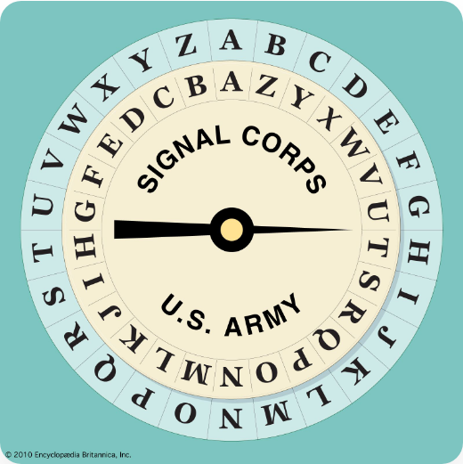
CORE TECHNIQUE
Substitution Ciphers
Mechanism: Replaces plaintext elements with alternate characters or symbols.
Objective: Obscures the meaning and semantic value of the original message.
Function: Creates "Confusion" by complicating the key-to-ciphertext link.
Monoalphabetic
Polyalphabetic
Like the Caesar Cipher. Shifts letters by a fixed amount. Extremely weak structure.
Like the Vigenère Cipher. Uses multiple shifting alphabets to increase complexity.

Slide 4
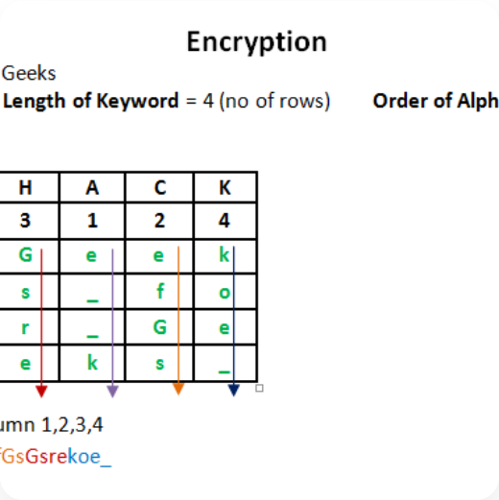
CORE TECHNIQUE
Transposition Ciphers
Mechanism: Rearranges the positions of existing characters.
Objective: Scrambles original order without altering identities.
Function: Creates "Diffusion" by spreading local structure across the ciphertext.
Rail Fence
Columnar
Writes text in a zigzag pattern. A highly basic geometric scrambling method.
Writes into a grid, then reads out columns based on a keyword's alphabetical order.

Slide 5
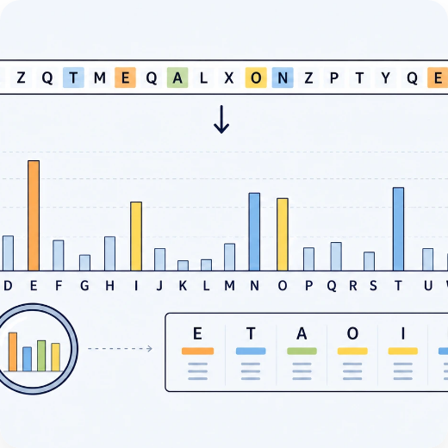
THE VULNERABILITY
Defeating Substitution
12.7%
Natural frequency of 'E' in the English language.
Since substitution maintains the original character frequencies, attackers map common ciphertext symbols back to vowels. This was famously documented by Al-Kindi in the 9th Century.

Slide 6
THE VULNERABILITY
Defeating Transposition
Anagramming
Known Plaintext
Key Limitations
Exploiting language patterns to logically reconstruct scrambled word blocks.
Using a known phrase to easily reveal the column length and grid structure.
Short transposition keys are highly susceptible to rapid brute-force attacks.

Slide 7
The Security Verdict
Claude Shannon's dual pillars of modern cryptography.
Substitution (Confusion)
Transposition (Diffusion)
Alters character identities.
Alters character positions.
Hides the relationship between ciphertext and key.
Dissipates statistical structure across the text.
Broken by structural anagramming.
Broken by statistical frequency analysis.

Slide 8
THE SOLUTION
The Product Cipher
Substitution Round (Confusion)
To overcome individual weaknesses, modern cryptography cascades multiple weak ciphers into a single, impenetrable system.
Transposition Round (Diffusion)
Concept: Alternating layers of substitution and transposition.
Substitution Round (Confusion)
Result: A synergistic effect where weaknesses cancel out.
Standard: Modern algorithms like AES.

Slide 9
THE GOLD STANDARD
Advanced Encryption Standard (AES)
AES explicitly pairs both techniques in 10 to 14 rounds, processing 128-bit blocks to achieve unbreakable military-grade security.
SubBytes
ShiftRows
MixColumns
SUBSTITUTION PHASE
TRANSPOSITION PHASE
DIFFUSION AMPLIFIER
Replaces each byte using a non-linear S-box, ensuring robust Confusion against frequency attacks.
Cyclically shifts matrix rows to cleanly scatter state bytes across multiple columns.
Mathematically combines bytes in each column to trigger a massive structural avalanche effect.

